Slide 1

JavaScript Syntax
Syntax, Conditions, Loops, Functions Etc.
SoftUni Team
Technical Trainers
Software University
https://softuni.bg

Slide 2
Table of Contents
JavaScript Introduction
Variables and Operators
Conditions: if-else, switch
Loops: for, while, do-while, …
Functions
Objects
Arrays
Strings

Slide 3

Introduction to JavaScript

Slide 4
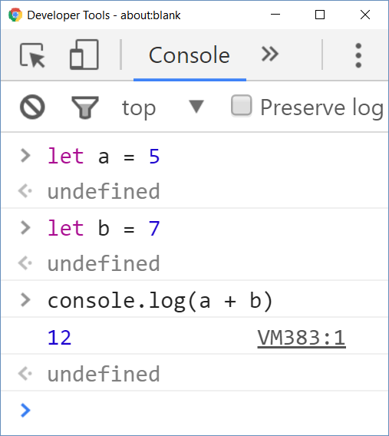
JavaScript
JavaScript is a dynamic programming language
Executes commands (script)
Can work in interactive mode
No compilation, just execute commands

Slide 5
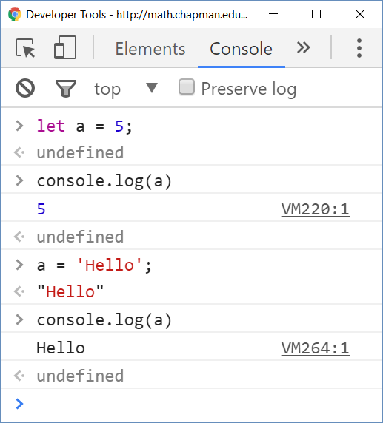
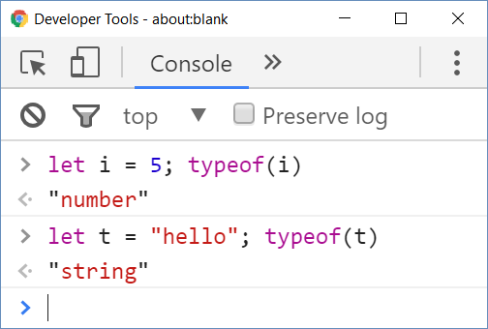
JavaScript
JavaScript is untyped language
Untyped (dynamically typed) == variables have no types
Data (values) still have a type

Slide 6
Data Types
Seven data types that are primitives
String - used to represent textual data
Number - a numeric data type
Boolean - a logical data type that can have only the values true or false
Undefined - is a value automatically assigned to variables that have just been declared, or to formal arguments for which there are no actual arguments
Null - represents the intentional absence of any object value
BigInt - represent integers with arbitrary precision
Symbol - symbols are new to JavaScript. A Symbol is a unique and immutable primitive value
Object - In JavaScript, objects can be seen as a collection of properties

Slide 7
Variable Values
Used to store data values
Variables that are assigned a non-primitive value are given a reference to that value
Undefined variable is a variable that has been declared with a keyword, but not given a value
Undeclared variables is a variable that hasn't been declared at all
let a;
console.log(a); // undefined
console.log(undeclaredVariable);
// ReferenceError: undeclaredVariable is not defined

Slide 8
Define Variables
Define variables with the keyword let
let i = 5; let j = 3; // i and j are numbers
console.log(typeof(i)); // Number
i = i * j; i++; // 16
console.log(i + 1); // 17
The ; can be omitted
let str = 'Hello'; // string
str = str + " JS";
console.log(str); // Hello JS
Strings are in format '…' or "…"
console.log(s2); // Uncaught ReferenceError: s2 is not defined
Undefined identifier usage

Slide 9

Operators
Arithmetic, Assignment, Comparison

Slide 10
Arithmetic Operators
Take numerical values (either literals or variables) as their operands
Return a single numerical value
Addition (+)
Subtraction (-)
Multiplication (*)
Division (/)
Remainder (%)
Exponentiation (**)
let a = 15;
let b = 5;
let c;
c = a + b; // 20
c = a - b; // 10
c = a * b; // 75
c = a / b; // 3
c = a % b; // 0
c = a ** b; //15⁵ = 759375

Slide 11
Problem: Calculate Expression
Write a program to print the value of the following expression: (30 + 25) + ((35 - 14) * 2)
Sample solution:
function solve() {
let val = (30 + 25) + ((35 - 14) * 2);
console.log(val);
}

Slide 12
Assignment Operators
Assign a value to its left operand based on the value of the right operand
Name
Shorthand operator
Basic usage
Assignment
x = y
x = y
Addition assignment
x += y
x = x + y
Subtraction assignment
x -= y
x = x - y
Multiplication assignment
x *= y
x = x * y
Division assignment
x /= y
x = x / y
Remainder assignment
x %= y
x = x % y
Exponentiation assignment
x **= y
x = x ** y

Slide 13
Comparison Operators
Operator | Notation in JS
EQUAL value EQUAL value and type | == ===
NOT EQUAL value NOT EQUAL value/type | != !==
Greater than | >
Greater than OR EQUAL | >=
LESS than | <
LESS than OR EQUAL | <=

Slide 14

Comparison Operators
console.log(1 == '1'); // true
console.log(1 === '1'); // false
console.log(3 != '3'); // false
console.log(3 !== '3'); // true
console.log(5 < 5.5); // true
console.log(5 <= 4); // false
console.log(2 > 1.5); // true
console.log(2 >= 2); // true

Slide 15
Truthy and Falsy Values
When we say that a value is "truthy" in JavaScript, what we mean is that the value coerces to true when evaluated in a boolean context
There are only six falsy values - false, null, undefined, NaN, 0 and ""
logTruthiness (3.14); //Truthy!
logTruthiness ({}); //Truthy!
logTruthiness (NaN); //Falsy.
logTruthiness ("NaN"); //Truthy!
logTruthiness ([]); //Truthy!
logTruthiness (null); //Falsy.
logTruthiness (""); //Falsy.
logTruthiness (undefined); //Falsy.
logTruthiness (0); //Falsy.
function logTruthiness (val) {
if (val) {
console.log("Truthy!");
} else {
console.log("Falsy.");
}
}

Slide 16
Logical Operators
&& (logical AND) - returns the leftmost false value
|| (logical OR) - returns the leftmost true value
let val = true && 'yes' && 5 && null && false;
console.log(val); // null
let val = true && 'no' && 5 && 25 && 'yes';
console.log(val); // 'yes'
let val = false || 0 || '' || 5 || 'hi' || true;
console.log(val); // 5
let val = false || '' || null || NaN || undefined;
console.log(val1); // undefined

Slide 17
Logical Operators
! (logical NOT) - Returns false if its single operand can be converted to true; otherwise, returns true
let val = !true
console.log(val); // false
let val = !false;
console.log(val); // true

Slide 18
Typeof Operator
The typeof operator returns a string indicating the type of an operand
let val = 5;
console.log(typeof val); // number
let str = 'hello';
console.log(typeof str); // string
let obj = {name: 'Maria', age:18};
console.log(typeof obj); // object

Slide 19

Conditional Statements
If - Else Statements

Slide 20
Conditions: If-else Statement
JavaScript implements the classical if / if-else statements:
let number = 5;
if (number % 2 == 0) {
console.log("Even number");
} else {
console.log("Odd number");
}
Boolean expressions

Slide 21
Problem: Bigger Number
Write a program to print bigger of two numbers:
function biggerNumber(input) {
let firstNumber = Number(input[0]);
let secondNumber = Number(input[1]);
if (firstNumber > secondNumber) {
console.log(firstNumber);
} else {
console.log(secondNumber);
}
}

Slide 22
The Switch-case Statement
Selects a statement from a list depending on the value of the switch expression
let day = 3;
switch (day) {
case 1: console.log('Monday'); break;
case 2: console.log('Tuesday'); break;
case 3: console.log('Wednesday'); break;
// TODO: Add the other cases
case 7: console.log('Sunday'); break;
default: console.log('Error!'); break;
}

Slide 23

Loops
For/while/do-while

Slide 24
Loops: for, While, Do-while, …
The for / while / do-while loops
for (let i = 0; i <= 10; i++)
console.log(i); // 0 1 2 3 4 … 10
let count = 1;
while (count < 1024)
console.log(count *= 2); // 2 4 8 16 … 1024
let s = "ha";
do { console.log(s); s = s + s; }
while (s.length < 10); // ha haha hahahaha

Slide 25
Problem: Print First 20 Numbers
Write a program to print first 20 numbers:
Use for, while or do-while loop:
function printFirstTwentyNumbers() {
for (let i = 1; i <= 20; i++) {
console.log(i);
}
}
printFirstTwentyNumbers();

Slide 26

Functions
Subprogram Designed to Perform a Particular Task

Slide 27
Functions
Functions hold a piece of code (script)
Can take parameters and return result
function multiply(a, b) {
return a * b;
}
console.log(multiply(2, 3)); // 6 == 2 * 3
console.log(multiply(2)); // NaN == 2 * undefined
console.log(multiply(5, 6, 7)); // 30 == 5 * 6

Slide 28
Declaring Functions
Function declaration
Function expression
Arrow functions
function walk() {
console.log("walking");
}
let walk = function (){
console.log("walking");
}
let walk = () => {
console.log("walking");
}

Slide 29
Parameters
You can istantialize parameters with no value
The unused parameters are ignored
function foo(a,b,c,d) {
console.log(a); // 1
console.log(b); // 2
console.log(c); // 3
console.log(d); // undefined
}
foo(1,2,3);
function foo(a,b,c) {
console.log(a); // 1
console.log(b); // 2
console.log(c); // 3
}
foo(1,2,3,6,7);

Slide 30
Arguments
Arguments - object which looks like array
Through arguments you can access parameters that are not passed in the function
In arrow functions you don't have access to arguments
Changing the arguments object is not a good practice
function foo(a,b,c) {
console.log(arguments[0]); // 1
console.log(arguments[4]); // 7
console.log(arguments[3] + arguments[4]); // 13
console.log(arguments); //[Arguments] { '0': 1, '1': 2, '2': 3, '3': 6, '4': 7 }
}
foo(1,2,3,6,7);

Slide 31
Nested Functions
Functions can be nested - hold other functions
Inner functions have access to variables from their parent
function hypotenuse(m, n) { // outer function
function square(num) { // inner function
return num * num;
}
return Math.sqrt(square(m) + square(n));
}
3, 4
5

Slide 32
Objects, Arrays, Strings
{…}; […]; '…'
{…} […] “…”

Slide 33
Objects
Objects in JavaScript hold key-value pairs:
let obj = { name : "SoftUni", age : 2 };
console.log(obj);
// Object {name: "SoftUni", age: 2}
obj['site'] = "http://www.softuni.bg";
obj.age = 10;
obj['name'] = "Software University";
console.log(obj);
// Object {name: "Software University", age: 10, site: "http://www.softuni.bg"}
delete obj.name;
delete obj.site;
console.log(obj);
// Object {age: 10}

Slide 34
Objects and JSON
JavaScript objects can be stored as text in JSON format
let obj = { name : "SoftUni", age : 2 }
let str = JSON.stringify(obj);
console.log(str);
// { "name":"SoftUni", "age":2 }
let str = '{"name":"Nakov","age":24}'
let obj = JSON.parse(str);
console.log(obj);
// Object { name: "Nakov", age: 24 }

Slide 35
Arrays
Arrays can hold mixed types:
// Array holding numbers
let numbers = [1, 2, 3, 4, 5];
// Array holding strings
let weekDays = ['Monday', 'Tuesday', 'Wednesday',
'Thursday', 'Friday', 'Saturday', 'Sunday'];
// Array of mixed data
var mixedArr = [1, new Date(), 'hello'];

Slide 36
Problem: Print the Elements in Array
Write a program to print all of the elements in array:
Create random array like this:
Put your solution in function
function solve(input) {
for (let element of array) {
console.log(element);
}
}
let numbers = [1, 2, 3, 4, 5];
solve(numbers);

Slide 37
Processing Arrays Elements
Print all elements of an array of strings:
let capitals = ['Sofia', 'Washington', 'London', 'Paris'];
for (let capital of capitals)
console.log(capital);
for (let i in capitals)
console.log(capitals[i]);
for (let i = 0; i < capitals.length; i++)
console.log(capitals[i]);
Works like foreach
This is not foreach! It goes through the array indices.
Traditional for-loop

Slide 38
Array Operations
let numbers = [1, 2, 3, 4];
console.log(numbers.join('|')); // result: 1|2|3|4|5
numbers.push(5);
console.log(numbers.join('|')); // result: 1|2|3|4|5
let tail = numbers.pop(); // tail = 5;
console.log(numbers.join('|')); // result: 1|2|3|4
numbers.unshift(0);
console.log(numbers.join('|')); // result: 0|1|2|3|4
let head = numbers.shift(); // head = 0;
console.log(numbers.join('|')); // result: 1|2|3|4

Slide 39
The map() method
The map() method creates a new array with the results of calling a provided function on every element in the calling array.
let numbers = [6, 42, 4, 81, 56, 33];
// Multiply every value by two.
let multipliedNumbers = numbers.map(number => number * 2);
console.log(multipliedNumbers); // [ 12, 84, 8, 162, 112, 66 ]
console.log(numbers); // [ 6, 42, 4, 81, 56, 33 ]

Slide 40
The map() method
6
42
4
81
56
33
func
func
func
func
func
func
new value
new value
new value
new value
new value
new value

Slide 41
Strings
Strings hold a sequence of Unicode characters
let str1 = "Some text in a string variable";
let str2 = 'Text enclosed in single quotes';
for (let i = 0; i < str1.length; i++)
console.log(str1[i] + ' ' + str2[i]);
let tokens = 'C#, Java, PHP ,HTML'.split(',');
// tokens = ['C#', ' Java', ' PHP ', 'HTML']
tokens = tokens.map(s => s.trim());
console.log(tokens);
// ['C#', 'Java', 'PHP', 'HTML']
Map by lambda function

Slide 42


Live Exercises

Slide 43

Summary
JavaScript is a dynamically-typed language
Commands are arranged in scripts
Program logic (variables, conditions, loops) are similar to C# / Java / PHP / C++
Arrays in JS combine traditional arrays, lists and dictionaries
Objects in JS hold key-value pairs
JS is a functional language: relies on functions, callbacks, lambdas, etc.
…
…
…

Slide 44












SoftUni Diamond Partners

Slide 45




SoftUni Organizational Partners

Slide 46
Questions?
Notes:
46

Slide 47

License
This course (slides, examples, demos, exercises, homework, documents, videos and other assets) is copyrighted content
Unauthorized copy, reproduction or use is illegal
© SoftUni - https://softuni.org
© Software University - https://softuni.bg
Notes:
47

Slide 48
Trainings @ Software University (SoftUni)
Software University - High-Quality Education, Profession and Job for Software Developers
softuni.bg, softuni.org
Software University Foundation
softuni.foundation
Software University @ Facebook
facebook.com/SoftwareUniversity
Software University Forums
forum.softuni.bg
Notes:
48

